Slide 1
A food delivery service has to deal with a lot of perishable raw materials which makes it all, the most important factor for such a company is to accurately forecast daily and weekly demand. Too much inventory in the warehouse means more risk of wastage, and not enough could lead to out-of-stocks - and push customers to seek solutions from your competitors. The replenishment of majority of raw materials is done on weekly basis and since the raw material is perishable, the procurement planning is of utmost importance.
Description of Problem

Slide 2
Business Impact
It empowers companies to rapidly address sudden changes in customer needs and facilitates building a data-driven supply chain.
Machine learning algorithms help businesses detect and measure the impacts of meteorological elements on sales.
Allows suppliers and retailers to effectively address weather-associated surges and drops in local demand.
Food wastage will be negligible as well as there will be no hike in prices.
No shortage of food will be there.
Demand sensing solutions extract daily data from POS systems, warehouses, and external sources to detect an increase or decrease in sales by comparison with historical patterns.

Slide 3
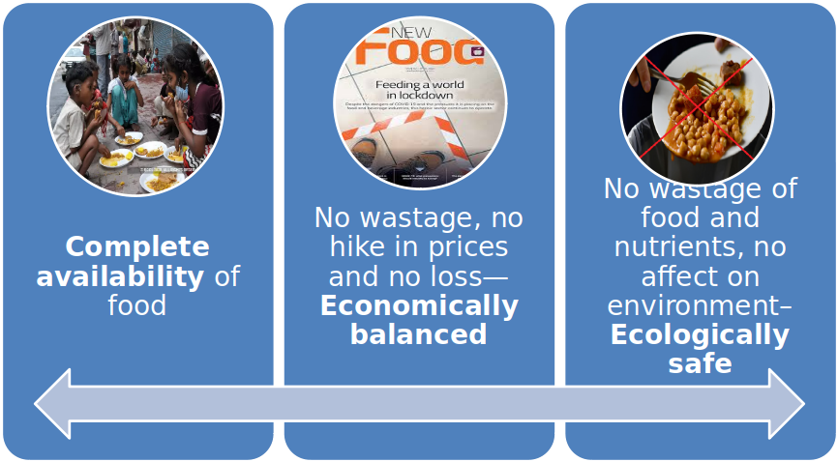
Social Impact

Slide 4
Novelty / Uniqueness
Website will recommend about state with extremely low demand in general, so company can ignore that state or district as it will save transportation charges.
Same thing for state with high demand. There company can use cheap transport like ship where there is huge demands.
Our model will not only tell about number of prediction but Will give demand for every type of food Separately.
On our website people can give suggestion about new food product and review on current food product. Later on when website will have gotten enough reviews, we can train our machine learning model to classify positive and negative reviews.

Slide 5
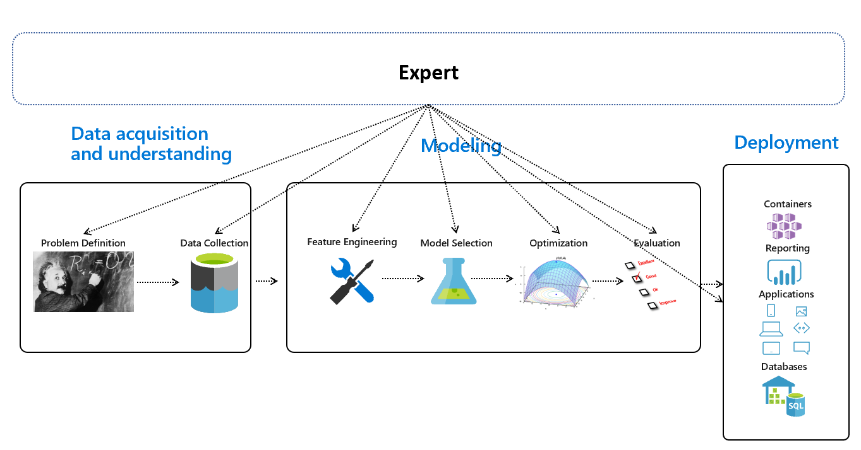
Architectural flow of the solution

Slide 6








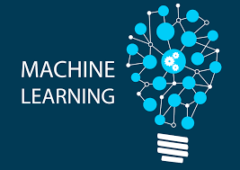

Technology Stack
Web App

Slide 7


FRONT END
HTML
CSS
JAVASCRIPT
BOOTSTRAP
JQUERY
BACK END
Python
Database :
MYSQL/SQLite
Cloud
ML / AI
Python
Jupyter
Google Colab
Other Libraries...

Slide 8
Scope Of Work
Phase 1 – Discovery ( 1 to 2 day)
The goal here is to identify the requirements and See if Machine learning meets the business goals. It requires us to try to understand more about the vision in terms of what issues we are looking to solve.
Secondly, our team will identify if we can provide more data for unique ideas by our members. Next, we have to gauge if we are able to supervise algorithms – if it returns correct response every time a prediction is made.
Deliverable –Data required for the unique ideas to be implemented in order to improve site further.
Phase 2 – Exploration (4 to 5 days)
The goal of this stage is to build upon a Proof of Concept which can then be installed as API. Once a baseline model is trained, we estimate the performance of the production-ready solution.

Slide 9
This stage gives us the clarity on what performance should be expected with the metrics planned at the discovery stage.
Deliverable – A Proof of Concept
Phase 3 – Development (12 to 15 days)
This is the stage where we as a team work iteratively till we reach a production ready answer. Because there are far less uncertainties by the time the project reaches this stage, the estimation gets very precise.
But in case the result is not improved, we would have to apply different model or rework on the data or even change the method, if needed.
In this stage, we work in sprints and decide what is to be done after every individual iteration. The outcomes of every sprint can be predicted effectively.
Deliverable – A production ready ML solution

Slide 10
Phase 4 – Improvement (6 to 7 days)
Once deployed, decision makers are almost always in a hurry to end the project to save costs. While the formula works in 80% of the projects, the same doesn’t apply in Machine Learning apps.
What happens is that the data changes throughout the Machine Learning project timeline. This is the reason why an AI model has to be monitored and reviewed constantly – to save it from degradation.
The Machine Learning centred projects require time for achieving satisfying outcomes. Even when you find your algorithms beating the benchmarks right from the beginning, chances are that they would be one strike and the program might get lost when used on a different dataset.

